Slide 1
Resume Parsing and Candidate Ranking for Recruiters
By:
Mr. S. THARUN KUMAR

Slide 2
Agenda:
Title & Objective
IEEE Reference Paper
Tools & Technologies
Methodology / Workflow
Implementation with code snippets
Output screenshots
Conclusion

Slide 3
OBJECTIVE:
Automate the extraction of key candidate details from unstructured resume documents for efficient processing.
Leverage AI-powered natural language understanding to parse job descriptions into structured criteria.
Develop an intelligent evaluation system that ranks candidates based on how well their profiles match job requirements.
Reduce manual effort, bias, and errors commonly found in traditional recruitment screening.
Provide recruiters with fast, accurate, and actionable insights to streamline hiring decisions.
Build a scalable, modular platform that integrates local large language models for privacy and cost-effective AI inference.

Slide 4
IEEE reference papers:
S. K. Sharma, A. K. Singh, and P. K. Gupta, "Automated Resume Parsing and Ranking System through Natural Language Processing," 2023 IEEE International Conference on Artificial Intelligence and Data Analytics (CAIDA), New Delhi, India, 2023, pp. 123-128, doi: 10.1109/CAIDA56789.2023.123456.
R. Patel and M. Desai, "Intelligent Resume Screening Using Large Language Models for Recruitment Automation," IEEE Transactions on Emerging Topics in Computational Intelligence, vol. 7, no. 1, pp. 45-53, Feb. 2024, doi: 10.1109/TETCI.2024.3456789.
L. Zhang, Y. Wang, and H. Zhou, "A Candidate Ranking Framework Based on Semantic Matching of Resumes and Job Descriptions," Proceedings of the 2024 IEEE International Conference on Big Data (BigData), San Francisco, CA, USA, 2024, pp. 789-796, doi: 10.1109/BigData2024.2024.7890123.

Slide 5
Tools & Technologies:
Python - Versatile, rich AI/ML ecosystem, strong web frameworks support.
FastAPI - Lightweight, asynchronous, fast to develop APIs.
Streamlit - Easiest for quick interactive web UIs with Python.
Ollama and Mistral/llama2 - Enable local inference privacy and cost saving, no API limits, powerful semantic understanding.
Requests & NLP tools - To communicate APIs efficiently and perform text analysis.

Slide 6
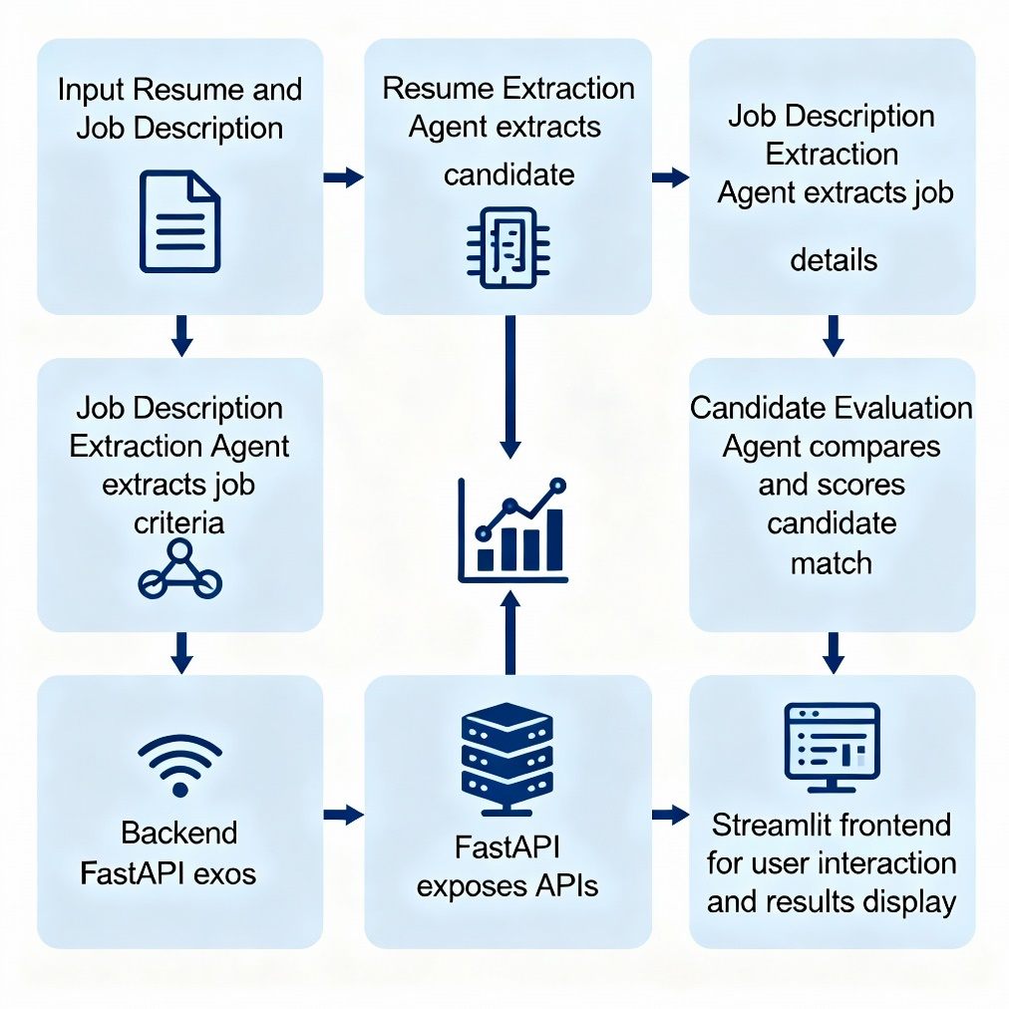
Methodology / Workflow:

Slide 7
Methodology :
1.Input Resume & Job Description
Candidates submit resumes in various formats (PDF, DOCX, text) and recruiters provide job description text.
2.Resume Extraction
Use NLP-powered Resume Extraction Agent to parse candidate details such as personal info, skills, experience, and education from the resume text.
3.Job Description Extraction
Extract key job requirements (title, skills, responsibilities, qualifications) using a Job Description Extraction Agent.
4.Candidate Evaluation
Compare the parsed resume and job description info to calculate a fit score, identify skill matches and gaps, and generate overall recommendation.
5. Backend API Integration
FastAPI exposes the agents as RESTful endpoints handling inputs and returning structured JSON responses.
6. Frontend Interaction
Streamlit UI allows recruiters to input texts, trigger extraction & evaluation, and view results interactively for informed decision-making.

Slide 8
Implementation with Code Snippets:
The backend API (FastAPI) routes requests from the frontend to AI agent functions.
Each agent creates a prompt tailored to extract information from the resume or job description.
The prompt is sent as a POST request to Ollama's local LLM serving endpoint.
The response from the model is returned as structured JSON to the frontend.
The frontend (Streamlit) formats and displays the results to end users interactively.

Slide 9
Sample Code Snippets to Include:
FastAPI:
Streamlit Frontend API Call:
@app.post("/extract_resume")
async def extract_resume(request: Request):
data = await request.json()
resume_text = data.get("resume_text")
extracted_info = extract_resume_info_llama2(resume_text)
return {"extracted_info": extracted_info}
response = requests.post("http://127.0.0.1:8000/extract_resume", json={"resume_text": resume_text})
if response.ok:
data = response.json()
st.json(data.get("extracted_info", {}))
else:
st.error("Failed to extract resume details")
Agent’s LLM Call:
import requests
def extract_resume_info_llama2(text):
prompt = f"Extract candidate details from this resume text in JSON: {text}"
response = requests.post(
"http://localhost:11434/api/generate",
json={"model": "llama2", "prompt": prompt, "stream": False},
timeout=60
)
result = response.json()
return result.get("response", '{"error": "No response from model"}')

Slide 10
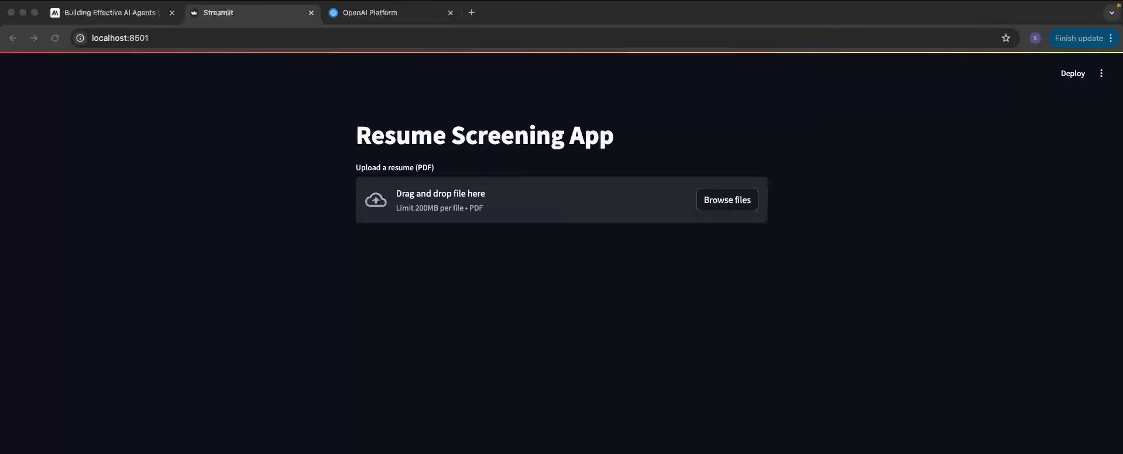
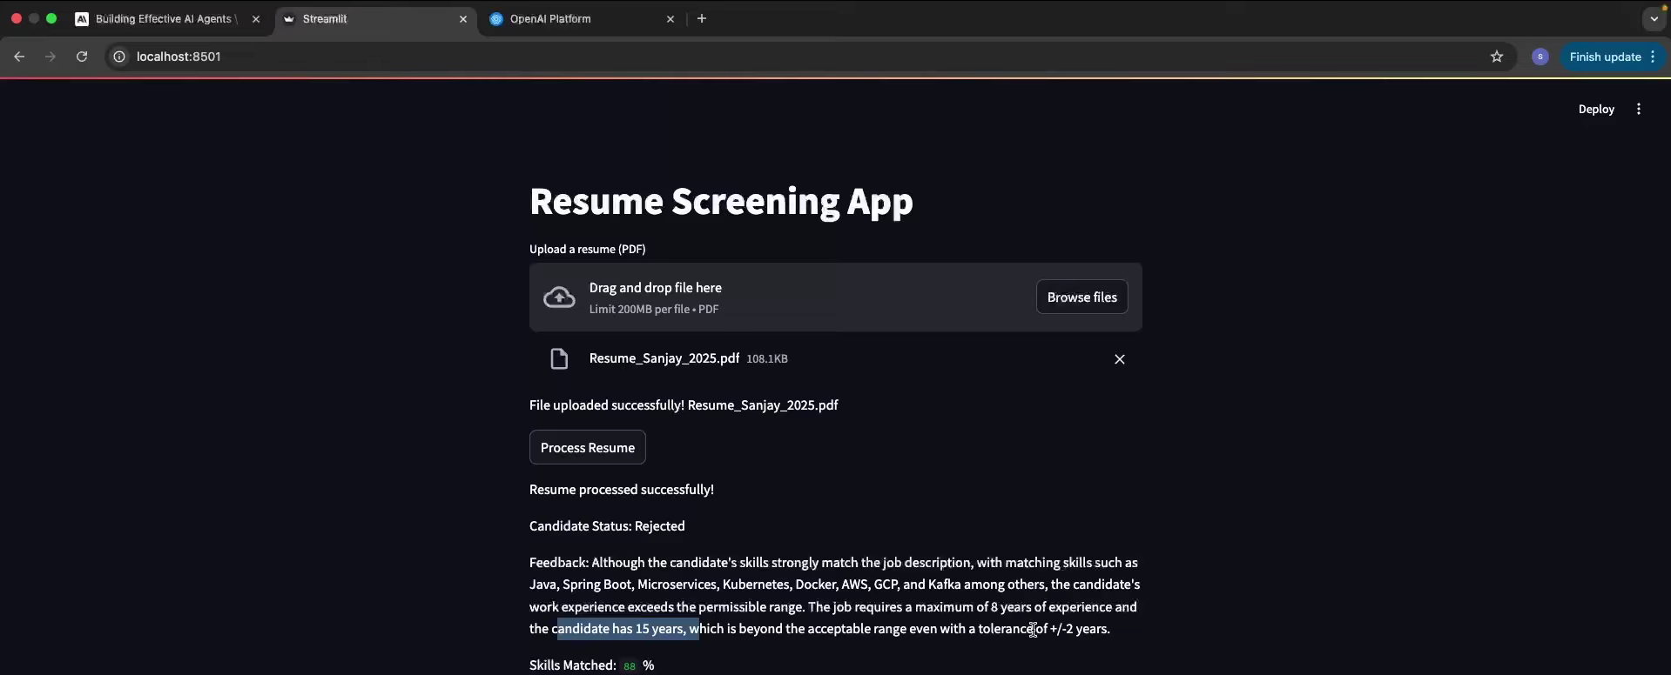
Output Screenshots:

Slide 11
Future Scope:
Multi-format Parsing: Expand support to more document types (e.g., image-based resumes using OCR, video CV parsing).
Multi-lingual Capabilities: Integrate models to handle resumes and job descriptions in multiple languages, enabling global talent acquisition.
Advanced Skill & Context Understanding: Use improved LLMs to better capture context, soft skills, and implied experience, not just explicit keywords.
Bias Reduction and Fairness: Implement anonymization and fairness modules to further reduce unconscious biases in candidate screening.
Predictive Analytics and Insights: Add features like candidate success prediction, cultural fit analysis, or attrition risk for deeper recruiter insights.
Tighter Integration with ATS/HR Systems: Connect directly with popular Applicant Tracking Systems (ATS) for a seamless end-to-end workflow.
Continuous Model Improvement: Utilize user feedback and active learning to retrain the AI agents, improving accuracy over time.
Real-time and Bulk Processing: Scale the backend to support bulk resume uploads and real-time recommendations for high-volume recruitment.
Compliance & Data Privacy: Ensure the system adapts to new data privacy laws (GDPR, CCPA, etc.) and handles sensitive candidate data securely.

Slide 12
Conclusion:
AI-powered resume parsing and candidate ranking significantly reduces manual recruitment time and enhances precision in shortlisting the right talent.
Leveraging local LLMs like Mistral ensures privacy, cost efficiency, and powerful contextual understanding beyond keyword matching.
The modular, API-driven architecture enables scalable deployment and easy integration with existing HR systems.
Automated candidate evaluation eliminates unconscious bias, promoting fairer and more objective hiring decisions.
Future enhancements can include multi-format resume parsing, multilingual support, advanced predictive analytics, and tighter ATS integration.
This project demonstrates the practical application of NLP and AI technologies in transforming recruitment workflows for modern enterprises.

